Slide 1

DATA – ARTIFICIAL INTELLGENCE
MySQL Database (JIT)
Trainer: Abhishek Sarkar

Slide 2
DATA MODELING IN ACTION
DATABASE ESSENTIALS
DATA MODELING
FOR
HEARTiHEALTH
(Case Study)
Notes:
YOU SHOULD HVE THE DB DEISGN SHARED. THEY SHOULD SEE THE TABLES AND ALSO THE DESIGIN THAT IS GIVEN. MAP THE DESIGN TO TABLES. ENTITIES, ATTRIBUTES, RELATIONSHIPS, KEYS

Slide 3
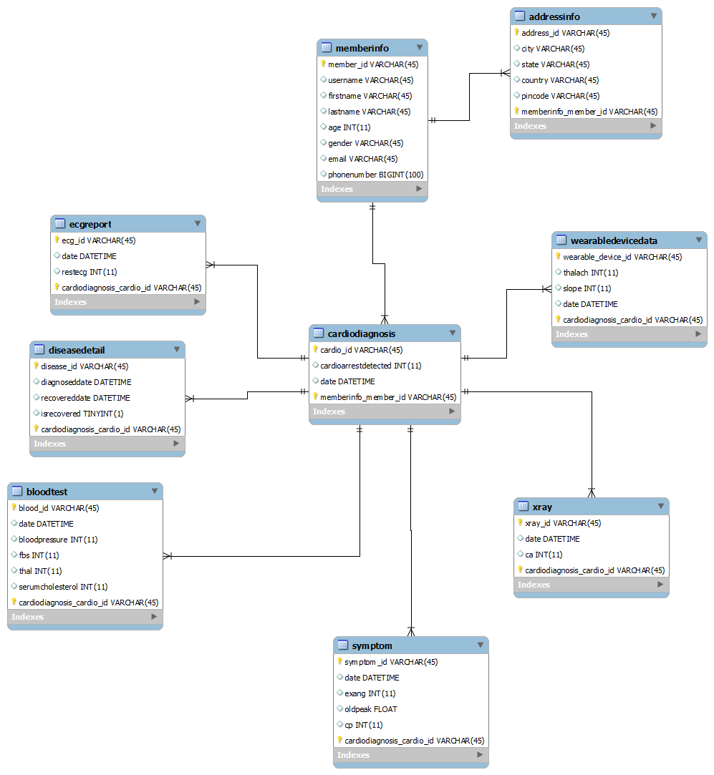
Create the entities and the attributes for HeartiHealth and design a Data Model Diagram or ERD with proper relationships
DATA MODELING IN ACTION
Lab - 1
DATABASE ESSENTIALS

Slide 4
The project owner of HeartiHealth has asked to provide one more feature to the existing application. As patient reviews and opinions matter the most for the services that are provided to them, capturing the reviews from the patients is a new feature that needs to be introduced.
DATA MODELING IN ACTION
DATABASE ESSENTIALS
Lab - 2
Task:
Add a new entity “Review” to the existing design. The entity must contain the attributes – ReviewType and Reviews, where reviews can be specific to the condition, medication, reports, visits, etc.

Slide 5
TRANSACTIONS AND QUERIES WITH DATA
DATABASE ESSENTIALS
ENTERPRISE DATA STORES
ONLINE TRANSACTIONAL PROCESSING DATABASES
AND
TRANSACTIONS
Notes:
YOU SHOULD HVE THE DB DEISGN SHARED. THEY SHOULD SEE THE TABLES AND ALSO THE DESIGIN THAT IS GIVEN. MAP THE DESIGN TO TABLES. ENTITIES, ATTRIBUTES, RELATIONSHIPS, KEYS

Slide 6
TRANSACTIONS WITH QUERIES
DATABASE ESSENTIALS
SQL stands for Structured Query Language
Simple, powerful and standard data access language for relational database management systems
Creating, Updating,
Inserting, Deleting and Requesting
information from databases

Slide 7
Product Design Lab
DATABASE ESSENTIALS
Lab-3
The HeartiHealth application is being used by a lot of members, and there are a lot of feedback and enhancements which the members are requesting the team to incorporate it for the next version of the product. As a part of the HeartiHealth Database team, you need to understand the schema of the database, setup the database and also look into some basic queries.
Task:
Create the database schema for HeartiHealth in MySQL DB.
Run the script and INSERT data into the entities.
Execute SELECT statement to check the data

Slide 8
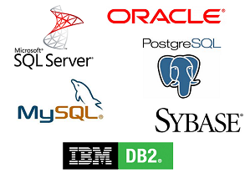
SQL Vendors
DATABASE ESSENTIALS
SQL servers and relational databases

Slide 9
JOINS AND QUERY FROM MULTIPLE OBJECTS
DATABASE ESSENTIALS
JOINS

Slide 10
JOINS AND QUERY FROM MULTIPLE OBJECTS
JOIN is a query that combines data from more than one table by means of a single statement
Joining is done in SQL by specifying the tables to be joined in the FROM clause
Most join queries contain WHERE conditions that compare two columns, each from a different table. Such a condition is called join condition
DATABASE ESSENTIALS

Slide 11
As per the requirement received by the project owner of HeartiHealth, the team has introduced a new section in the application called Statistics. This section need an analytical report of the heart attack predictions that are captured till date. The report will contain the total heart attack predictions for each day.
SQL IN ACTION
Lab - 4
DATABASE ESSENTIALS
Task:
Write a query to get all the predictions for the day, and sort it with the highest percentage of the probability at the top.

Slide 12
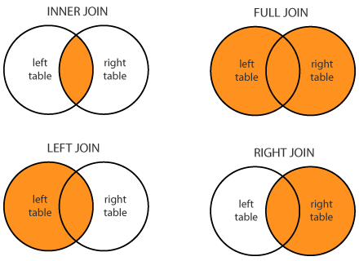
SQL JOINS
DATABASE ESSENTIALS
Types of Joins
A
B
A
B
A
B
A
B

Slide 13
SQL JOINS
DATABASE ESSENTIALS
Inner Join
The INNER JOIN keyword selects records that have matching values in both tables.
Example: To select all orders with customer information SELECT Orders.OrderID, Customers.CustomerName FROM Orders INNER JOIN Customers ON Orders.CustomerID = Customers.CustomerID;
Orders
Customers

Slide 14
SQL JOINS
DATABASE ESSENTIALS
Left Join
The LEFT JOIN keyword returns all records from the left table (table-A), and the matched records from the right table (table-B).
Left join selects data starting from the left table and matching rows in the right table. The left join returns all rows from the left table and the matching rows from the right table.
If a row in the left table does not have a matching row in the right table, the columns of the right table will have NULL.
Example: To select all customers, and any orders they might have SELECT Customers.CustomerName, Orders.OrderID FROM Customers LEFT JOIN Orders ON Customers.CustomerID = Orders.CustomerID ORDER BY Customers.CustomerName;
A
B

Slide 15
SQL JOINS
DATABASE ESSENTIALS
Right Join
The RIGHT JOIN keyword returns all records from the right table (table-B), and the matched records from the left table (table-A). The result is NULL from the left side, when there is no match.
Example: To return all employees, and any orders they might have placed SELECT Orders.OrderID, Employees.LastName, Employees.FirstName FROM Orders RIGHT JOIN Employees ON Orders.EmployeeID = Employees.EmployeeID ORDER BY Orders.OrderID;
A
B

Slide 16
SQL JOINS
DATABASE ESSENTIALS
Full Join
The FULL OUTER JOIN keyword returns all records when there is a match in left (table-A) or right (table-B) table records.
The full outer join or full join returns a result set that contains all rows from both left and right tables, with the matching rows from both sides where available. In case there is no match, the missing side will have NULL values.
FULL OUTER JOIN and FULL JOIN are the same.
Example: To selects all customers, and all orders SELECT Customers.CustomerName, Orders.OrderID FROM Customers FULL OUTER JOIN Orders ON Customers.CustomerID = Orders.CustomerID ORDER BY Customers.CustomerName;
A
B

Slide 17
SQL IN ACTION
DATABASE ESSENTIALS
SQL
FOR
HEARTiHEALTH
Notes:
Actors:
Patient
Insurance companies
Hospitals
Doctors
Application

Slide 18
In order to conduct some survey, the project owner of HeartiHealth application has asked to get the information of some of the members who are registered with the application, based on the City where they are residing.
SQL IN ACTION
Lab - 5
DATABASE ESSENTIALS
Task:
You need to write a query to get all the members who are from the “Flora” city.

Slide 19
In the dashboard section of the application, the members/patients of HeartiHealth have requested to display the number of blood tests done for them.
SQL IN ACTION
Lab - 6
DATABASE ESSENTIALS
Task:
Write a query to get the total number of blood tests done for the member “Aisha”.

Slide 20
In the Labs section, all the lab reports for the tests which were conducted for the patients were uploaded into our system and are being stored in the database. These lab reports are stored date-wise. We have received a requirement, that the members now want to view the reports for a particular date.
SQL IN ACTION
Lab - 7
DATABASE ESSENTIALS
Task:
Write a query to get the xray details of “Ajay” whose cardio was done on “26th of Jan 2019”

Slide 21
SQL IN ACTION
DATABASE ESSENTIALS
Stored Routines
FOR
HEARTiHEALTH
Notes:
Actors:
Patient
Insurance companies
Hospitals
Doctors
Application

Slide 22
PL/SQL-Procedures
DATABASE ESSENTIALS
Procedures

Slide 23
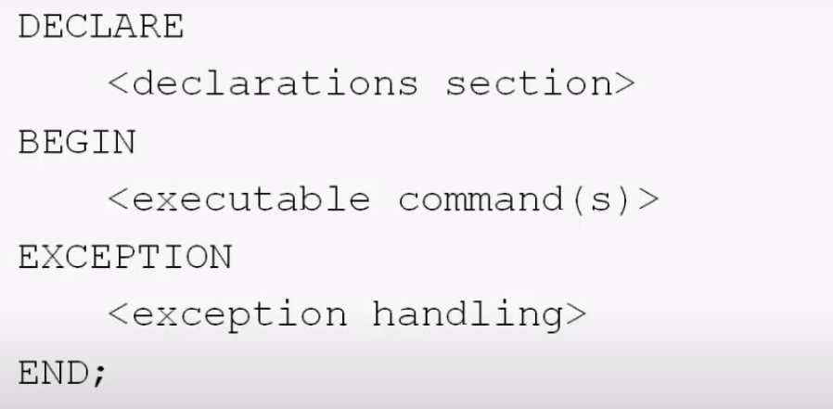
PL/SQL
PL/SQL Basic Block Syntax
DATABASE ESSENTIALS

Slide 24
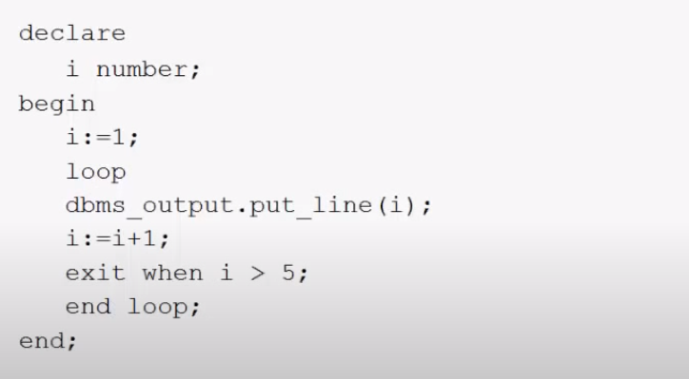
PL/SQL
Print natural numbers from 1 to 5
DATABASE ESSENTIALS

Slide 25
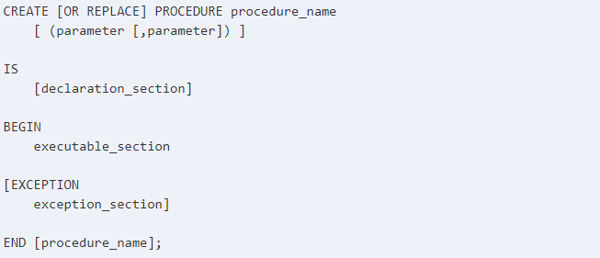
PL/SQL-Procedures
Create Procedure
DATABASE ESSENTIALS
The syntax to create a procedure in MySQL is:

Slide 26
PL/SQL-Procedures
Create Procedure
DATABASE ESSENTIALS
When you create a procedure or function, you may define parameters. There are three types of parameters that can be declared:
IN - The parameter can be referenced by the procedure or function. The value of the parameter can not be overwritten by the procedure or function.
OUT - The parameter can not be referenced by the procedure or function, but the value of the parameter can be overwritten by the procedure or function.
IN OUT - The parameter can be referenced by the procedure or function and the value of the parameter can be overwritten by the procedure or function.

Slide 27
PL/SQL-Procedures
DATABASE ESSENTIALS
Procedures Demo

Slide 28
We need to get the details of members based on their member ID, so store it as a stored procedure so that it can be used repeatedly.
PL/SQL-Procedures
Lab - 8
DATABASE ESSENTIALS
Task:
Create a Stored Procedure to get the details (firstname, lastname, age) of the members by just passing the member_id as a parameter.

Slide 29
Every time a new patient registers to the system, the details of the member needs to be captured. We need to get the details of a patient and insert it using a stored procedure.
PL/SQL-Procedures
Lab - 9
DATABASE ESSENTIALS
Task:
Create a Stored Procedure to insert the details of the any new member by just passing the details as parameters.

Slide 30
It is sometimes very difficult to find the reports of the patients. Writing a query everytime is also difficult. The DB admin has suggested to create customized Stored Procedures to get the reports(X-Ray) of the patients by just checking the name of the patient and when was he diagnosed for a cardiac test .
PL/SQL-Procedures
Lab - 10
DATABASE ESSENTIALS
Task:
Create a Stored Procedure to get the X-ray report of the patient, based on their name and the date of cardiac test done.

Slide 31
PL/SQL - Functions
DATABASE ESSENTIALS
Functions

Slide 32
PL/SQL - Functions
Create a PL/SQL Function
DATABASE ESSENTIALS
Similar to a procedure, a PL/SQL function is a reusable program unit stored as a schema object in the MySQL Database. The following illustrates the syntax for creating a function:
CREATE [OR REPLACE] FUNCTION function_name (parameter_list)
RETURN return_type
IS
[declarative section]
BEGIN
[executable section]
[EXCEPTION]
[exception-handling section]
END;

Slide 33
The admin of the hospital want to see the total number of patients who are predicted to have a heart attack and also those who are not in the application. Also this would help to create an analytics to measure the efficiency of the HeartiHealth Application.
PL/SQL - Functions
Lab - 11
DATABASE ESSENTIALS
Task:
Create a Function which would provide the count of the patients based on the data stored in the database. Pass the parameter to get count of patients who are predicted or who are safe from getting a heart attack.

Slide 34
PL/SQL - Cursors
DATABASE ESSENTIALS
Cursors

Slide 35

PL/SQL - Cursors
Create a PL/SQL Function
DATABASE ESSENTIALS
MySQL creates a memory area, known as the context area, for processing an SQL statement, which contains all the information needed for processing the statement; for example, the number of rows processed, etc.
A cursor is a pointer to this context area. PL/SQL controls the context area through a cursor.
A cursor holds the rows (one or more) returned by a SQL statement.
The set of rows the cursor holds is referred to as the active set.
Syntax of cursor

Slide 36
We would like to have a list of records of the patient who are more than 35 years of age. The DB Admin is facing a challenge to get the list using a Stored Procedure. Help him to solve his problem
PL/SQL - Cursors
Lab - 12
DATABASE ESSENTIALS
Task:
Create a Cursor to get the list of patients whose age is greater than 35 years. Call the cursor and print the member_id, username, firstname and age.

Slide 37
PL/SQL - Cursors
Lab - 13
DATABASE ESSENTIALS
Task:
Create a Cursor to print the list of all member within the cursor. Execute the cursor so that it print in this way:
Ex: The member name is : Rahul Sharma
<Note: Do not call the cursor externally>

Slide 38
PL/SQL - Cursors
DATABASE ESSENTIALS
Cursors with Stored Procedures

Slide 39
The admin of the application is facing a challenge to fetch one record at a time for a member. He is looking for a solution to get the list of members based on certain condition, and store the query in a stored procedure, so that depending on the parameter he can anytime fetch the details of the members.
PL/SQL - Cursors
Lab - 14
DATABASE ESSENTIALS
Task:
Write a procedure which will display the list of all members from a given city.

Slide 40
In the HeartiHeath application, the hospital supervisor wants to get the list of patients for a particular age, as he wants to communicate to the patients and convey certain precaution measures to some category of patients. You need to help the DB team to ensure this functionality works.
PL/SQL - Cursors
Lab - 15
DATABASE ESSENTIALS
Task:
Write a procedure which will display the list of all members by passing a particular age.
Print the member_id, firstname, lastname, age, phone.

Slide 41
PL/SQL - Cursors
DATABASE ESSENTIALS
Triggers

Slide 42
PL/SQL - Triggers
Description
DATABASE ESSENTIALS
Triggers are stored programs, which are automatically executed or fired when some events occur.
Triggers are, in fact, written to be executed in response to any of the following events −
A database manipulation (DML) statement (DELETE, INSERT, or UPDATE)
A database definition (DDL) statement (CREATE, ALTER, or DROP).
A database operation (SERVERERROR, LOGON, LOGOFF, STARTUP, or SHUTDOWN).
Triggers can be defined on the table, view, schema, or database with which the event is associated.

Slide 43
PL/SQL - Triggers
Creating Triggers: Syntax
DATABASE ESSENTIALS
CREATE [OR REPLACE ] TRIGGER trigger_name
{BEFORE | AFTER | INSTEAD OF }
{INSERT [OR] | UPDATE [OR] | DELETE}
ON table_name
FOR EACH ROW]
WHEN (condition)
DECLARE
Declaration-statements
BEGIN
Executable-statements
EXCEPTION
Exception-handling-statements END;
Trigger Timing
Event
Row Level
Conditional Clause

Slide 44
The admin of HeartiHealth has noticed that many members are providing someone else’s email ID which is not supposed to be. May be the UI validation was not implemented yet. We need to validate the email IDs from the database level and show an error if that email address already exist in the database.
PL/SQL - Cursors
Lab - 17
DATABASE ESSENTIALS
Task:
Create a trigger, before a new member data is inserted into the database and validate if the email ID provided by the member already exist in the database or not.
Also, if the email does not exist in the database, we should allow to insert the data for the member.

Slide 45
It has been noticed that many members were removed, or some data were tampered, and there was no track of when it was done. There is a request from the admin team to log the changes for the member table so that we can know when a member is added or updated or removed from the system.
PL/SQL - Cursors
Lab - 19
DATABASE ESSENTIALS
Task:
Write a DDL Query Statement to create a new table memberLog, which will keep a log of any changes for the member’s data.
Attributes: change_date date,
mem_id varchar2(45),
operation varchar2(10),
description varchar2(50)

Slide 46

It has been noticed that many members were removed, or some data were tampered, and there was no track of when it was done. There is a request from the admin team to log the changes for the member table so that we can know when a member is added or updated or removed from the system.
PL/SQL - Cursors
Lab - 20
DATABASE ESSENTIALS
Task:
Create a trigger (memberLogTrigger ), which would log the data into the memberLog table whenever any new member is added in the database or if any member’s data is updated.
Sample:

Slide 47

UI Programming
Web Technologies & User Experience Design
THANK YOU

